Slide 1
Map Rules Management System ( MRMS )
An approach redefining creation and managing of Map Validation Rules
Subhendu Roy & Shishir B Saxena
03.03.2015

Slide 2
Agenda
Existing System
Limitations
Problems in hand
Proposed Solution
(Is There a) Need
Essential Ingredients
MRMS – High Level Components
MRMS – Process Flow
MRMS – Phases
Benefits, Limitations and Next Steps

Slide 3
Existing System: Limitations
Subject Matter Experts (SMEs) Perspective
A very detailed textual representation ( VRD ) to ensure that the engineering team understand the problem statement
Engineering Team Perspective
Need to have a good functional knowledge to understand the rules requirement
Not guaranteed that engineering team understand the whole context
Lack of visual representation of the outcome
The implementation is totally dependent on individual’s ability to understand the requirement based on VRD
Need to have good co-ordination with SMEs
Lack of automated test scenarios
A very engaged and consistent co-ordination with the engineering team
Increase efficiency of map-making through better process and technology
Increase efficiency of map-making through better process and technology

Slide 4
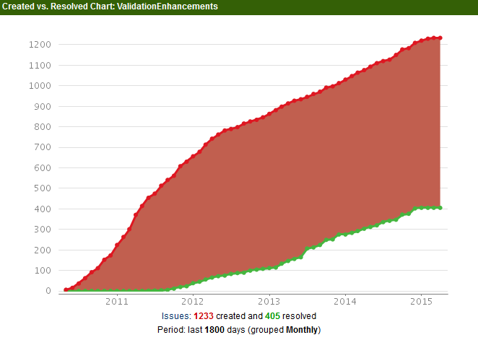
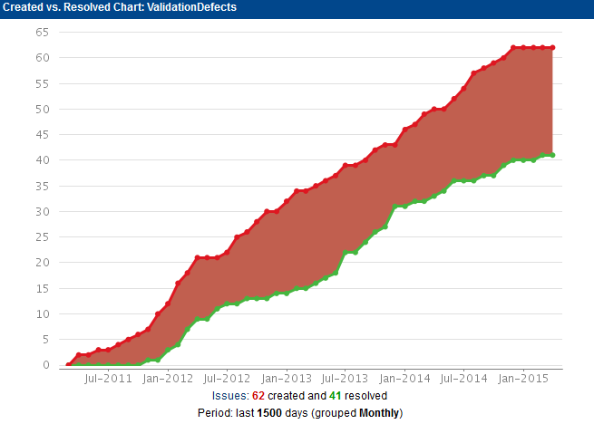
Existing System: Problems in hand
An ever increasing Backlog
Increase efficiency of map-making through better process and technology
Increase efficiency of map-making through better process and technology
Very high turn around time for implementation
Construction of a Rule takes 6-7 weeks on average
Development outcome is often not good enough and a lot of cases require multiple cycles (or rework) before final acceptance

Slide 5
Proposed solution:
Is there a Need ?
There is a dire need for the process to be highly integrated and automated
Essential Ingredients
Configurable and SME driven
Self-testable
The NextGen approach of map content as layers need to be respected
SMEs to have full control on rule definition and outcome
The rule definition need to be in a standardized language instead of textual form
Visualization to happen such that newly perceived rules definitions could be picked up in a map illustration and impact is understood with changing attributes
Efficient in a way that the rules defined could be plugged directly in the code
Increase efficiency of map-making through better process and technology
Increase efficiency of map-making through better process and technology

Slide 6



Map Rules Management System: High Level Components
Rules Studio - Authoring
Lightweight web app
Highly customized for the task
Professional UX
Rule Repository
Rules Repository
Rules for multiple layers
Version managed
Simple JSON schema
Rules Studio - Visualization
Lightweight Open Layer based web app
Color coded guided tools for users to quickly analyze and save results
Enables Self-test
Rule Engine
Executes Rules
Enables both SLV and XLV
A Cloud base solution ( ? )
Notes:
High precision and 3D content
Varying levels of quality and freshness

Slide 7
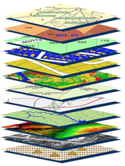
Map Rules Management System: Components Interaction Diagram
Rules Authoring and Decision Validation
a
RMOB
Carto
Places
NG
TBD
Rules Studio – Visualization
Rules Studio – Authoring
Layers
Rules Repository
Legacy Validation Framework
XLV System
Rules Engine
Rules Integration/Publish/Deploy

Slide 8
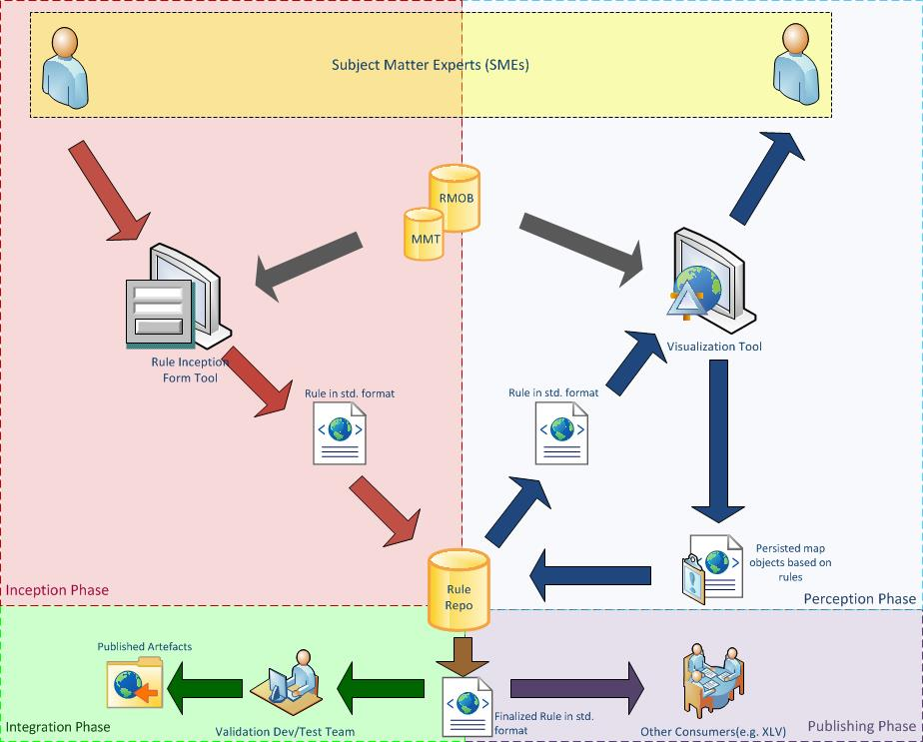
Increase efficiency of map-making through better process and technology
Map Rules Management System: Process Flow
Process Flow

Slide 9
Map Rules Management System: Phases
Rules Authoring
Decision Validation
Orchestration
Publish / Deploy
Manually review the result of the Rules on a given dataset
Save the result for automated self-test
Fine tune the Rule definition and self-test till the desired result is achieved
Define how the Rules should be executed
Integration of Rule into the main code ( Ideally, a Rule Engine should be able to execute the Rules without any manual integration effort )
Rules could be consumed by other systems ( existing XLV framework etc. ) and execute
SME’s to define Rules : Combination of attribute filters and message
The rule is saved in a standardized JSON format
Increase efficiency of map-making through better process and technology

Slide 10
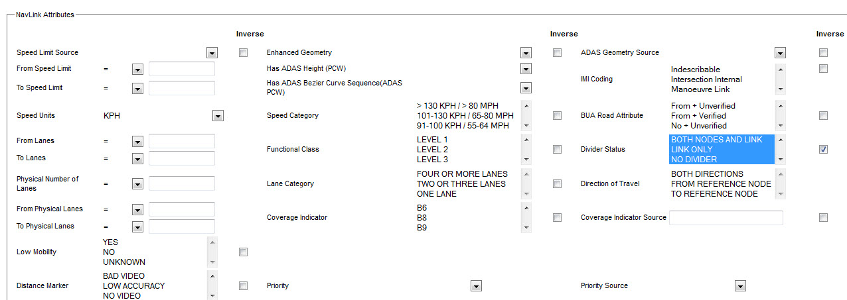
Map Rules Management System: Rules Authoring
Example Rule – NAV018
“An exception shall be present when a navigable link divider Location attribute has a value that is not present in the metadata domain DIVLOC” [Below image is a snapshot from QueryTool]

Slide 11
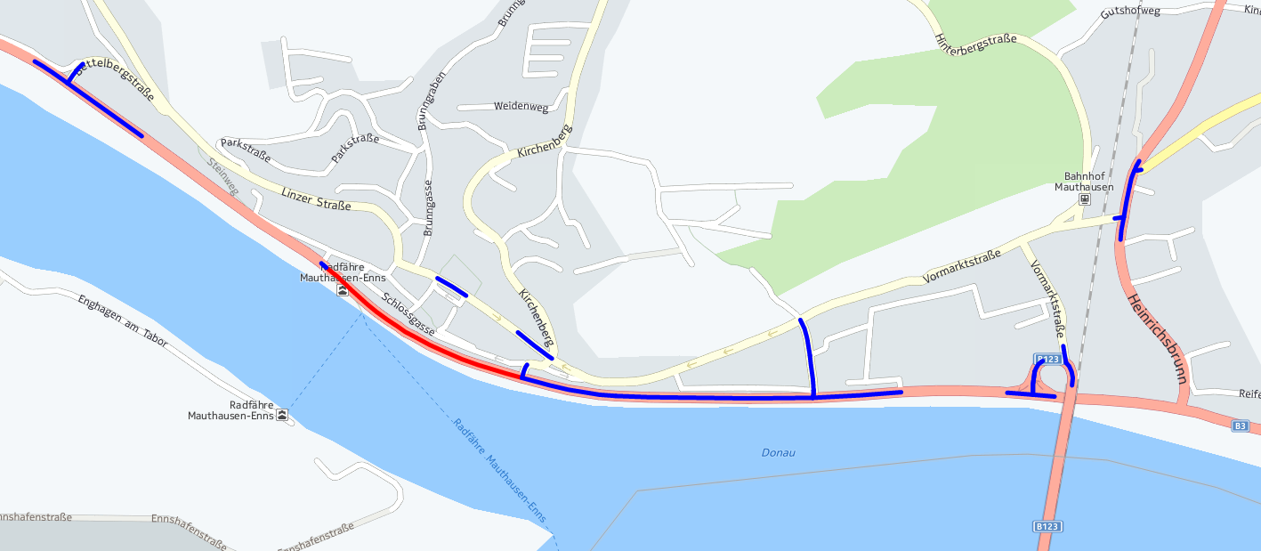

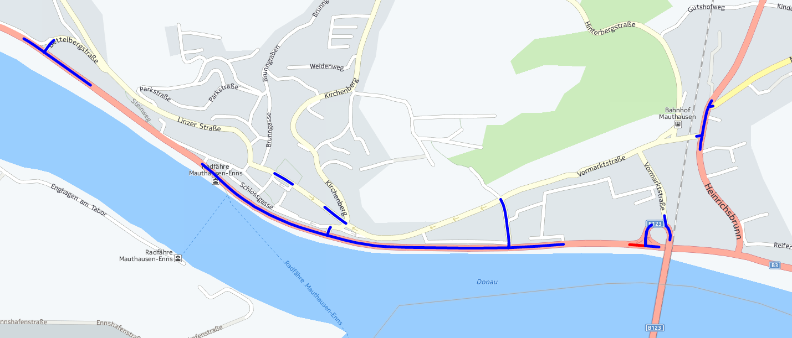
Map Rules Management System: Visualization App
Proposed Approach – Rule Visualization Module Overview
Exception:
FC2, FC2, FC4 present at intersection and Link PVID(s): 819091285, 569712726, 569712669 missing Sign(s) for one or more Destination Links
Attributes:
- Intersection Category: 0
- Sign Type: 6
- driver: N
- driver source: N
Increase efficiency of map-making through better process and technology
Link ID: 819091285
Rule Code(s):
- SGN050
More…
Exception:
Origin Link 62792048 to Link PVID 62792049 does not have an associated RDM applied
Attributes:
Intersection Category: 1
Direction of travel: 66
Link ID: 569712744
Rule Code(s):
- CON043
More…
Note: The above pictures are for illustrative purpose only

Slide 12
Map Rules Management System: Benefits and Limitations
Benefits
SME driven development
Developer’s job is limited only to rule integration
Inline with NextGen Architecture and all layers could directly use the rule(s)
Limitations
The very complex rules might have to take the traditional path
Faster turn around time due to less coordination and more automation
Rules will be categorized to enable both Single Layer Validation ( SLV) as well as Cross Layer Validation (XLV)
Seamless integration of intermediate format could be challenging initially
Optimal evolution of process would be dependent on various examples
Increase efficiency of map-making through better process and technology
Increase efficiency of map-making through better process and technology
Next Steps

Slide 13
Map Rules Management System: What Next ?
Increase efficiency of map-making through better process and technology
Next Steps
Detailed architecture for the entire process
Technology evaluation for the modules
Migration of existing rules
Increase efficiency of map-making through better process and technology
Next Steps

